Slide 1
Demographic
Gender : men – women
Age : (21-30)
Income : ( 3000-10000)
Education: University and Fresh Grads

Slide 2
Smart objective
Reach 1000 Person in first week.
Rease Engagement Rate by 10 %.
Rease Followe BY 100 .
Transform Followers to clients.

Slide 3
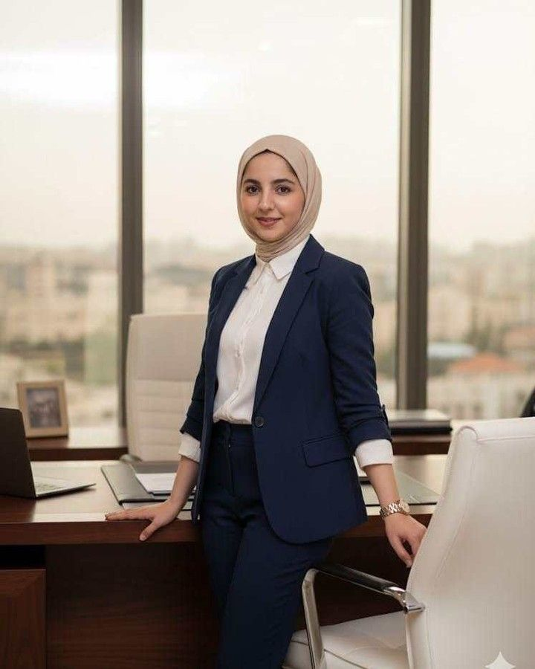
Demographics
Female
Age 21
Lives in an apartment in 6 October city.
Challenges
The "Empty Page" Syndrome: Having no professional work history to fill a CV.
Lack of Network: Doesn't know any "insiders" or recruiters in their field.
Imposter Syndrome: Feeling like they aren't "qualified" enough to even have a LinkedIn profile.
Identifiers
Using social media (Facebook -instegram )
Follows career influencers and educational creators
Anxious about having "zero experience" on their resume.
What can we do?
Design an academic CV that highlights student activities and projects.
Set up a LinkedIn profile that attracts recruiters even without corporate experience.
Sarrah
Othman
Background
Single.
She lives with her family.
Studied at faculty of science.
She is a fresh graduate.
looking for work.
Goals :
Secure a prestigious internship.
Build a professional LinkedIn presence from scratch.

Slide 4
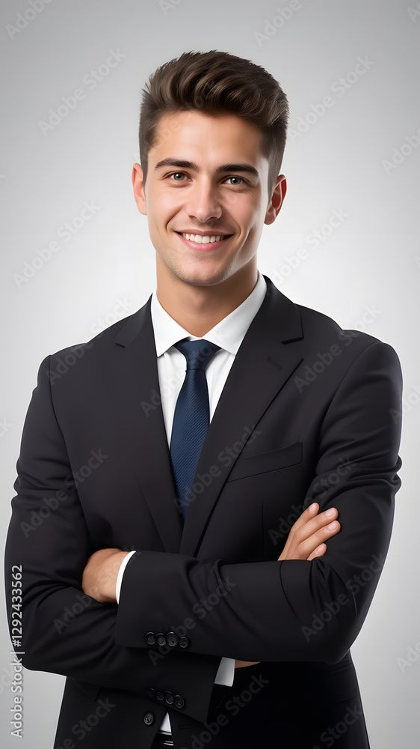
Demographics
Male
Age 23
Unemployed or in a temporary "survival" job
Budget: Limited (looking for high value at an affordable price).
Challenges
The ATS Black Hole: Sending hundreds of applications and getting zero responses (getting filtered out by bots).
Market Competition: Competing with thousands of other grads with the same degree.
The "Experience" Paradox: Seeing "Entry-level" jobs that require 2–3 years of experience.
Identifiers
Frustrated by "ATS" (Applicant Tracking Systems) rejections.
Spends hours on LinkedIn but doesn't know how to network.
Values "how-to" guides and success stories.
What can we do?
Write an ATS-optimized CV using industry-specific keywords.
Create a professional Portfolio/Website to visually prove their skills.
Amr
Hussen
Background
Single
Unemployed
Live alone and pays a rent .
He got trainings at some banks and companies.
Goals
Create a CV that passes ATS filters Increase performance without any risk of injuries.
Build a portfolio to showcase technical skills and graduation projects.

Slide 5
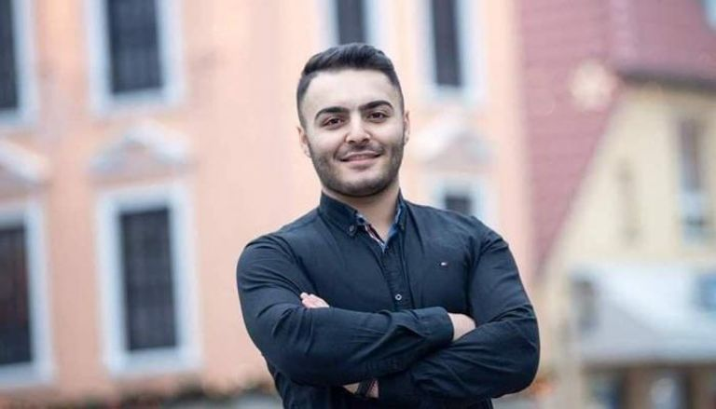
Demographics
Male
Age 25- 30
Status: Currently employed but seeking a total career change.
Location: Remote-work enthusiasts or city-based professionals.
Challenges
Irrelevant History: Their past 5 years of work look completely unrelated to the job they want now.
Lowered Authority: Feeling like they are "starting over" at the bottom of the ladder.
Keyword Gaps: Not knowing the specific "lingo" or buzzwords of the new industry to attract the right headhunters.
Identifiers
Active on LinkedIn and professional Facebook groups.
Has "transferable skills" but doesn't know how to market them.
Willing to invest more for a premium, expert-looking brand.
What can we do?
Revamp their LinkedIn headline and "About" section to reflect the new career path.
Structure their CV to highlight transferable skills rather than just old job titles.
Kareem
Said
Background
Married and has two kids
(boy& girl)
Work as an accountant .
Works for along time and the salary is not enough
Goals
Rebrand their professional identity for a new industry.
Position themselves as a "fast learner" with relevant past expertise.

